Slide 1

Open MeadoWatch
MeadoWatch: a long-term citizen-science phenological database of Mount Rainier Alpine Meadows

Slide 2
Brainstorming starting session
Objectives of the data paper:
make MW data available and useable for others
Give an easy way to cite and give visibility to the project.
Create a copy, open repository (updating? And living links?)

Slide 3
Brainstorming starting session
JOURNAL OPTIONS
Scientific Data
Ecology (data papers)
Others with experience?

Slide 4
Scientific data
STRUCTURE:
Small abstract
Background of the project and overview of the context and broader goals of the data collection.
Methods. (Bigger part). Details, design, and figures. (and applications and caveats).
Data records: essentially metadata
Technical validation.

Slide 5
QUESTIONS TO DISCUSS TODAY
What data to include
Figures and analyses that may be of interest
Data usage and other limitations we may put on the data

Slide 6
Which data to include?
Plot location and plot info
Raw phenological data (reports)
Meteorological data?
Snow cover data?
Phenological curves (calculated from phenological data)

Slide 7
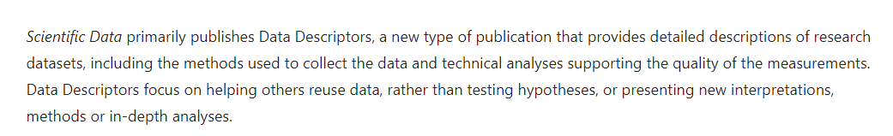
Figures and analyses?
The main idea of these papers’ analyses is NOT to test ecological ideas or new analyses but to help others understand and use the data:

Slide 8
Discussion:
Which information would you like to know from these dataset if you would never have seen it?
Eg. Plot locations on a map.

Slide 9
What did we have so far
Location and Extension
Temporal replication (per year)
Temporal replication (per month)
Target species composition and replication
Temporal resolution of the samples
Comparison of scientists-vs-citizens assessments

Slide 10
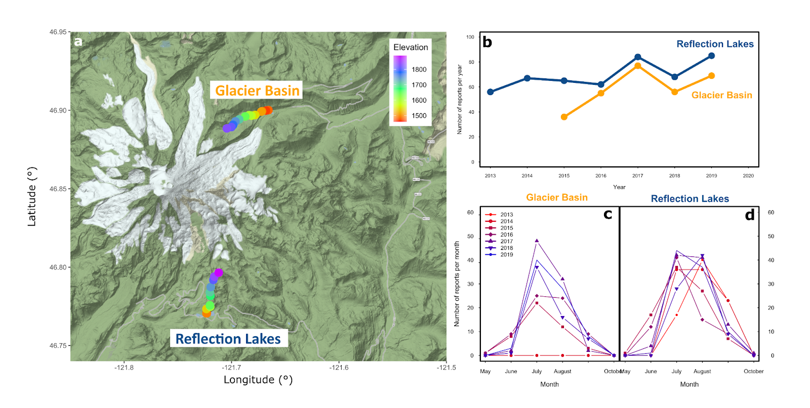
Location, temporal replication

Slide 11
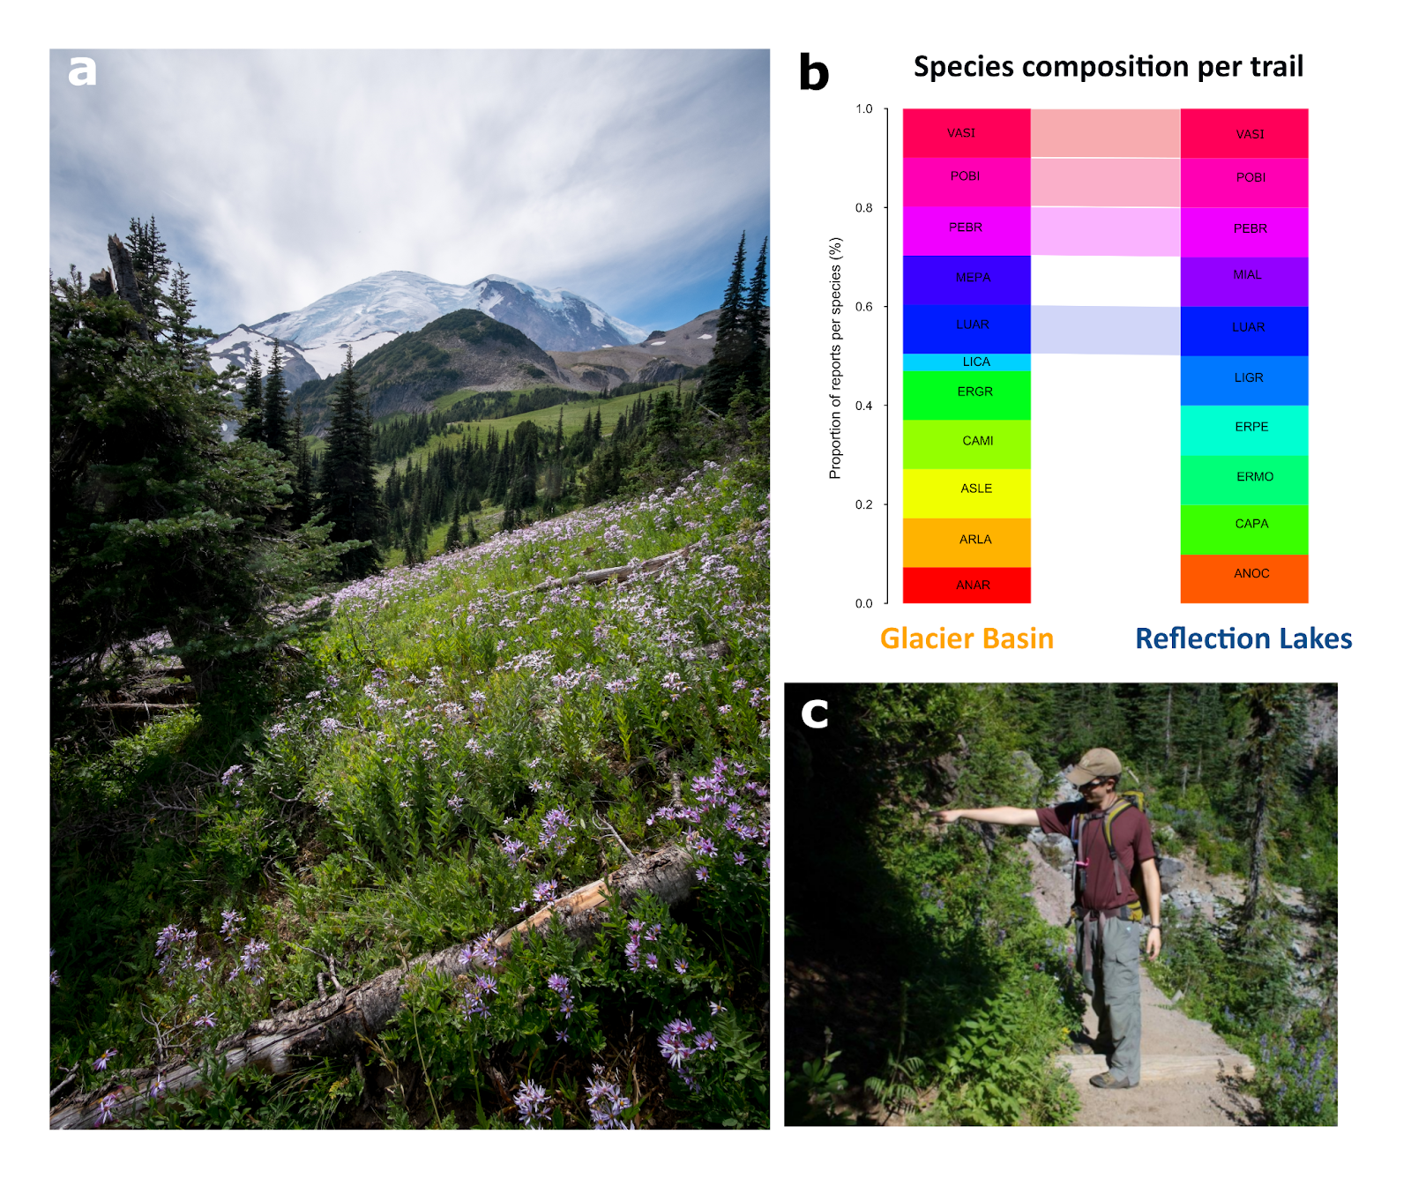
Species comp. +
Plot visual

Slide 12
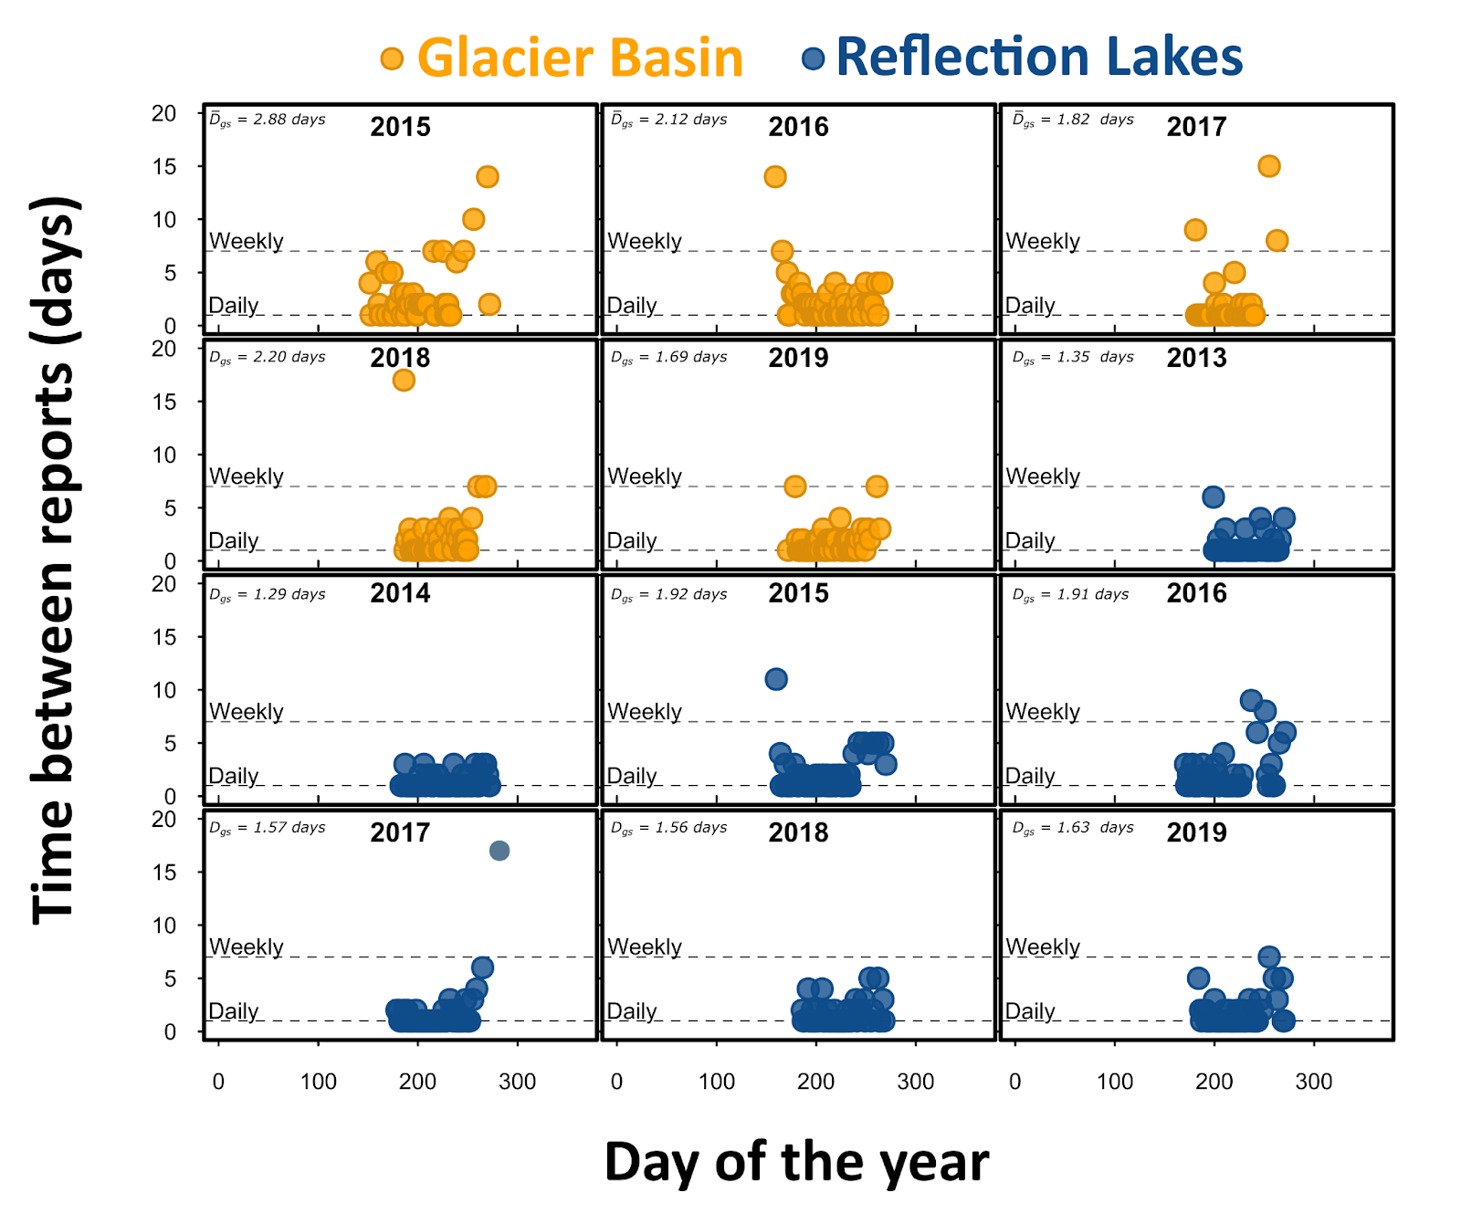
Temporal
resolution

Slide 13
AJI’s Shinny app to explore phenological curves

Slide 14
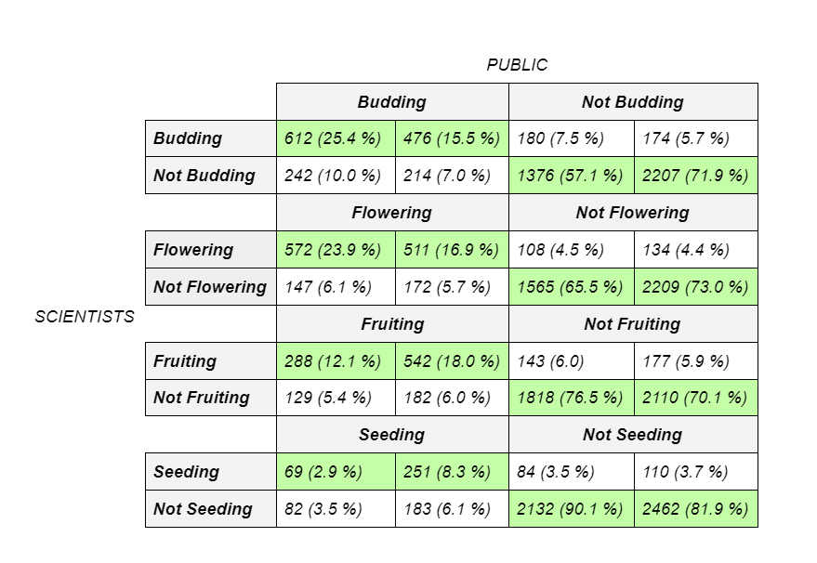
Comparison sci vs. cit
GB
RL

Slide 15
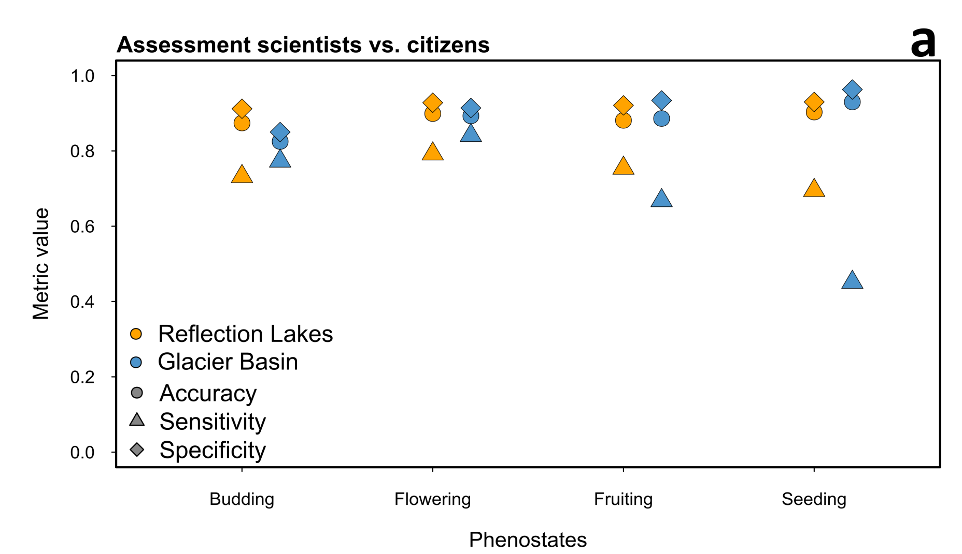
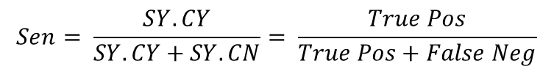
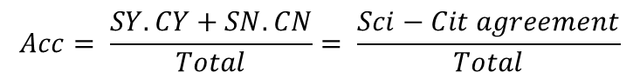
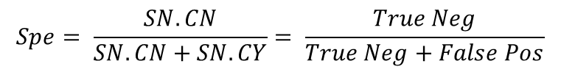
Comparison sci vs. cit
$$Acc= \frac{SY.CY+SN.CN}{Total}= \frac{Sci−Cit agreement}{Total}$$
(Accuracy = proportion of accurate assessments)
$$Sen= \frac{SY.CY}{SY.CY+SY.CN}= \frac{True Pos}{True Pos+False Neg}$$
(Sensitivity = how many of the ‘trues’ are detected)
(low sensitivity = citizens ‘missed’ stuff)
$$Spe= \frac{SN.CN}{SN.CN+SN.CY}= \frac{True Neg}{True Neg+False Pos}$$
(Specificity = how many of the ‘falses’ are detected)
(low specificity = citizens ‘imagined’ stuff)

Slide 16
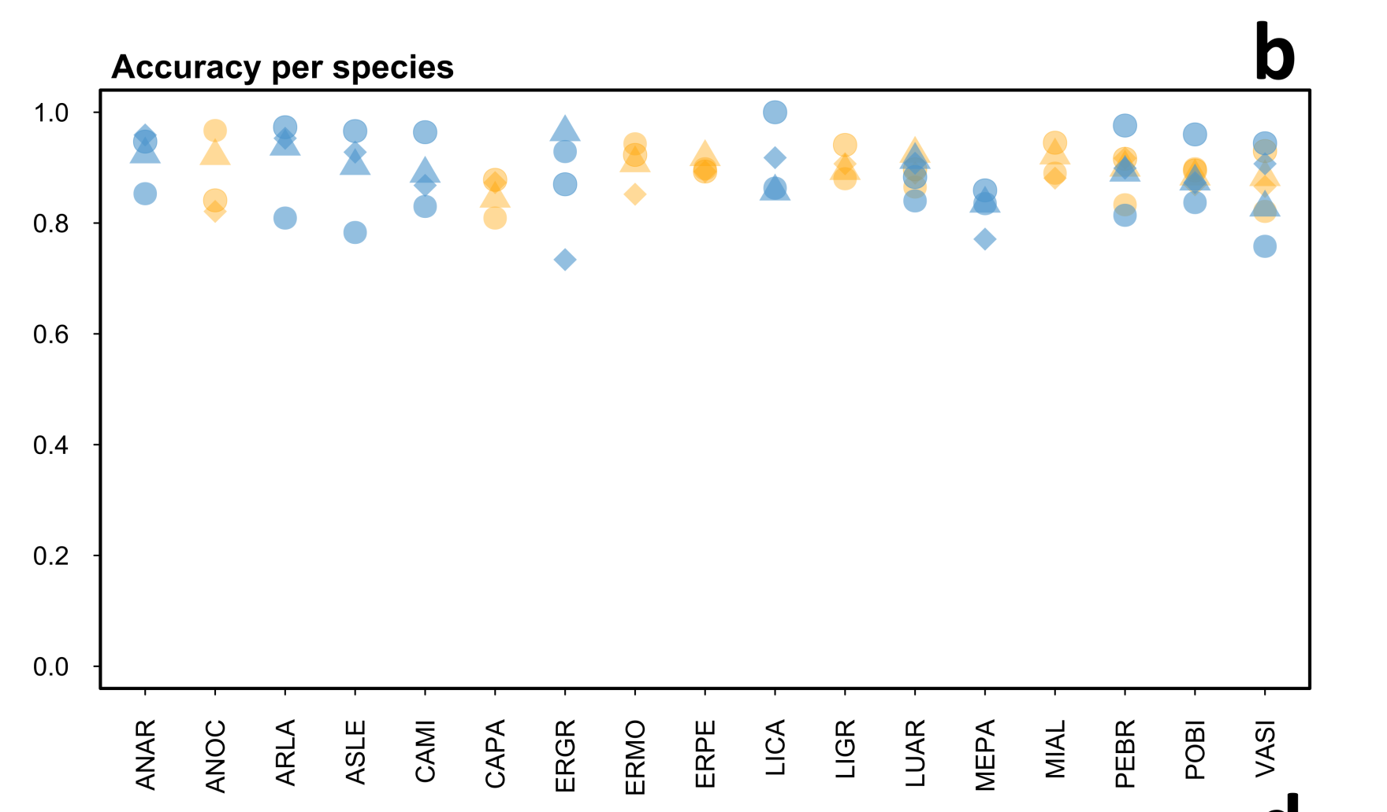
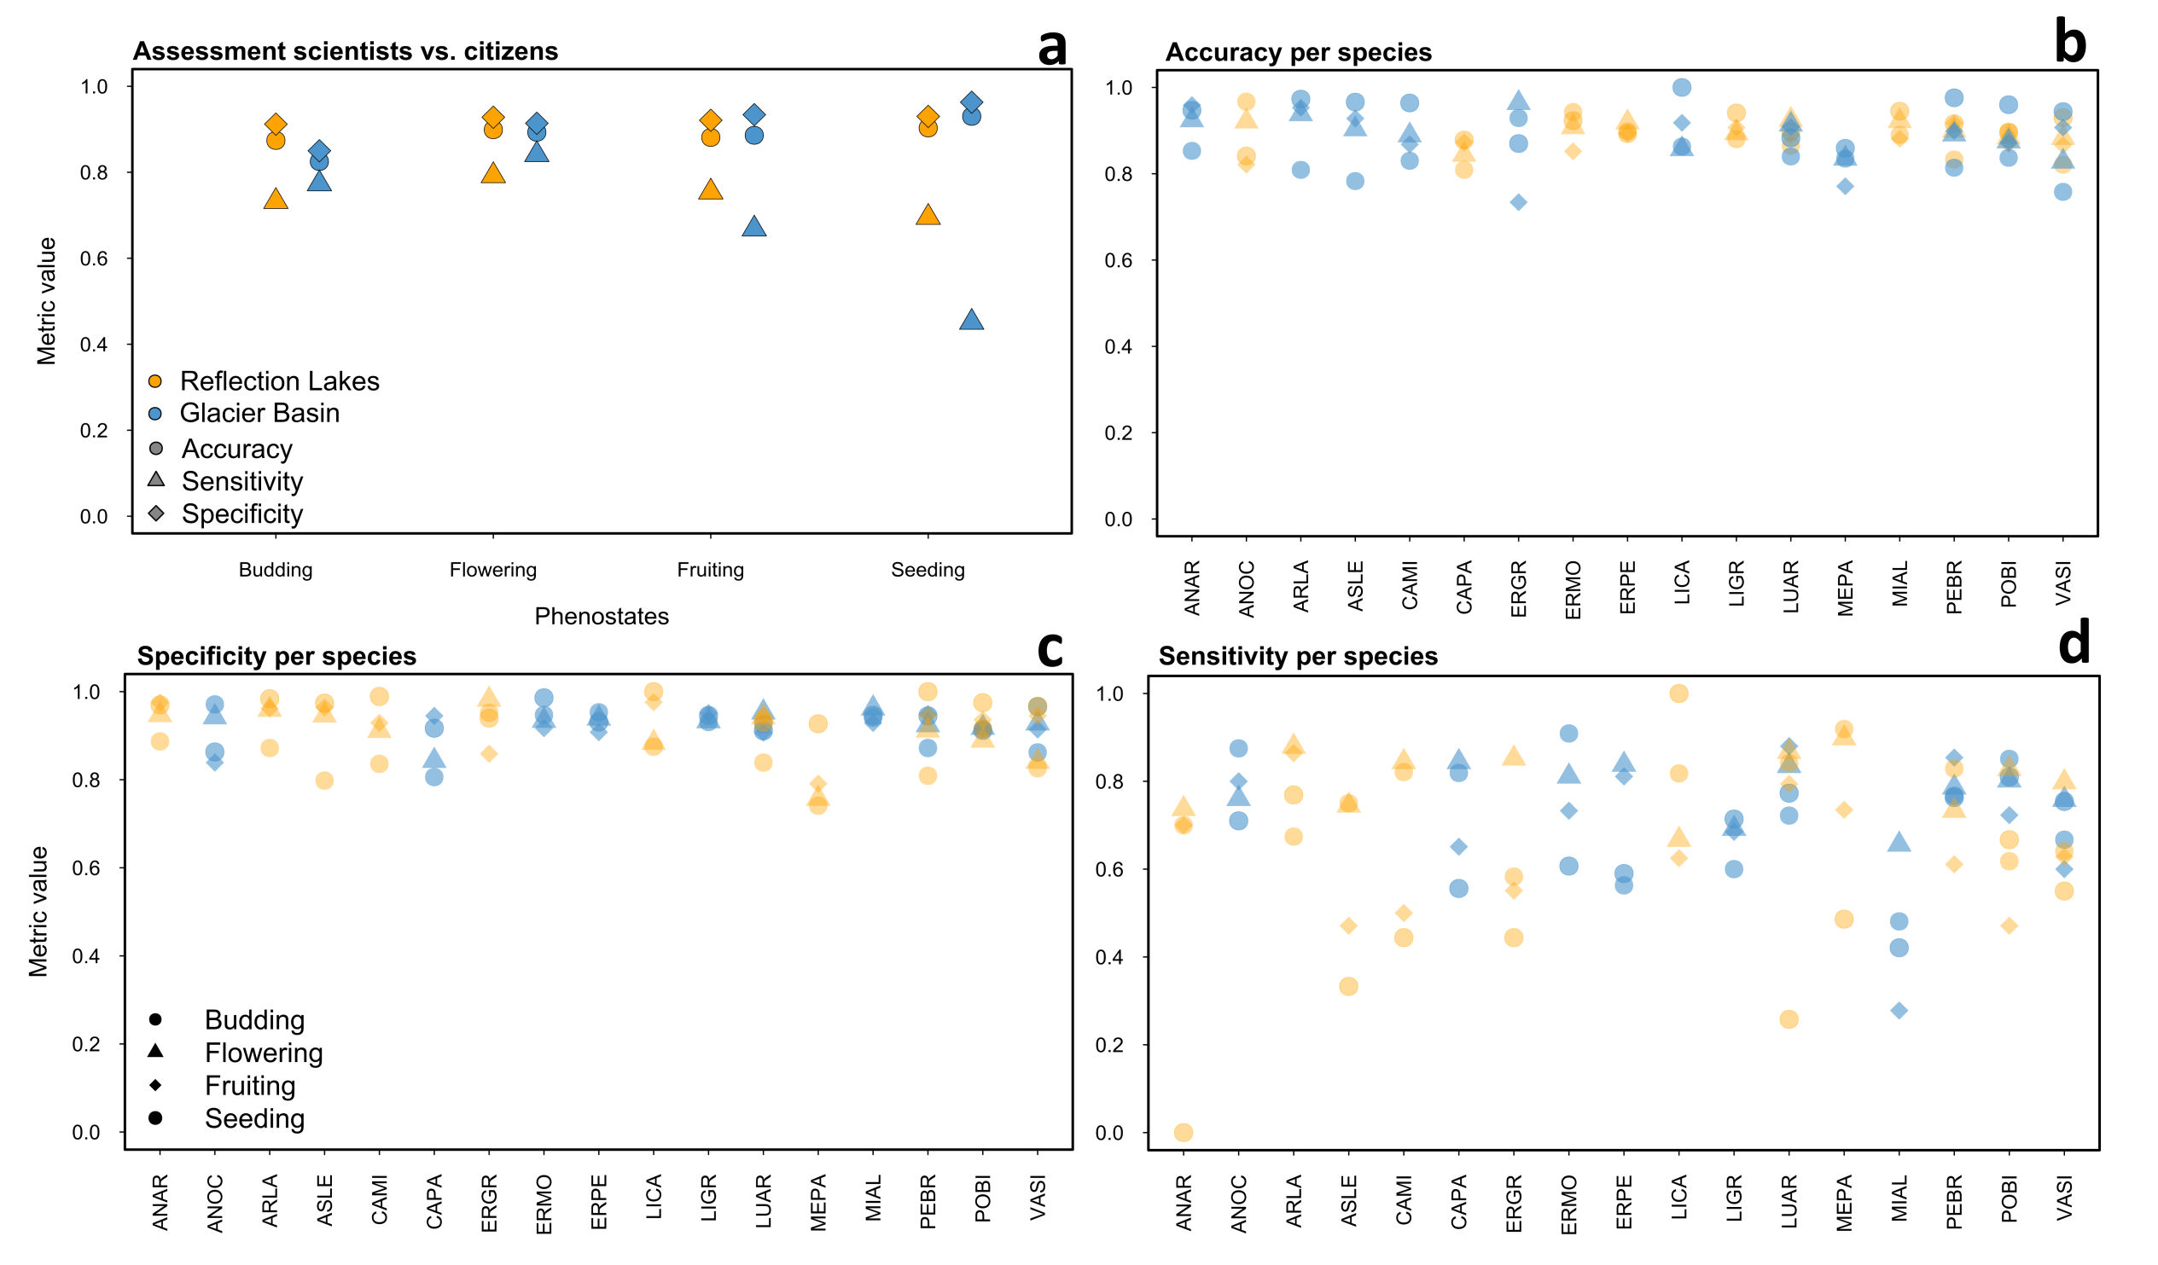
Comparison sci vs. cit

Slide 17
Comparison sci vs. cit

Slide 18
Comparison sci vs. cit

Slide 19

Comparison sci vs. cit

Slide 20
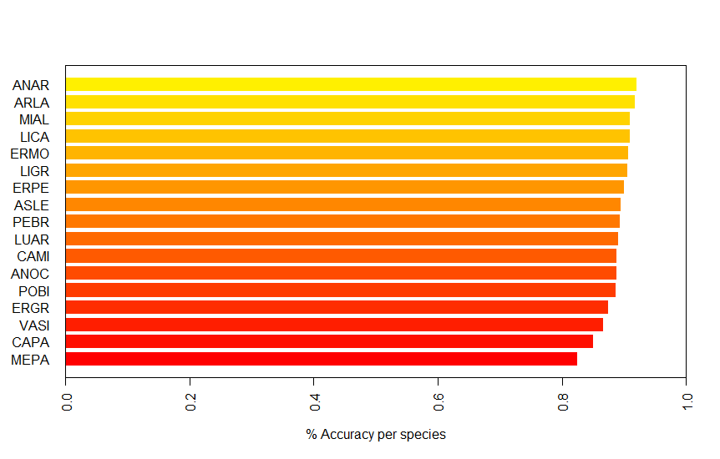
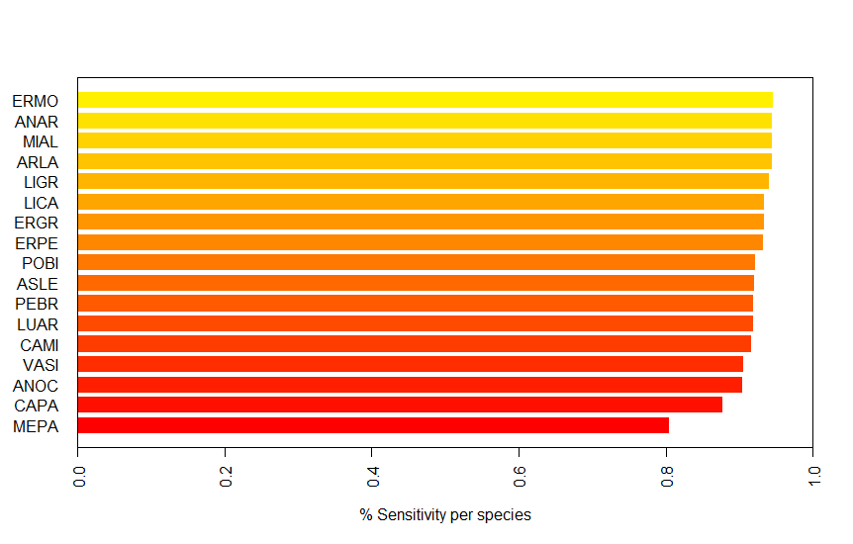
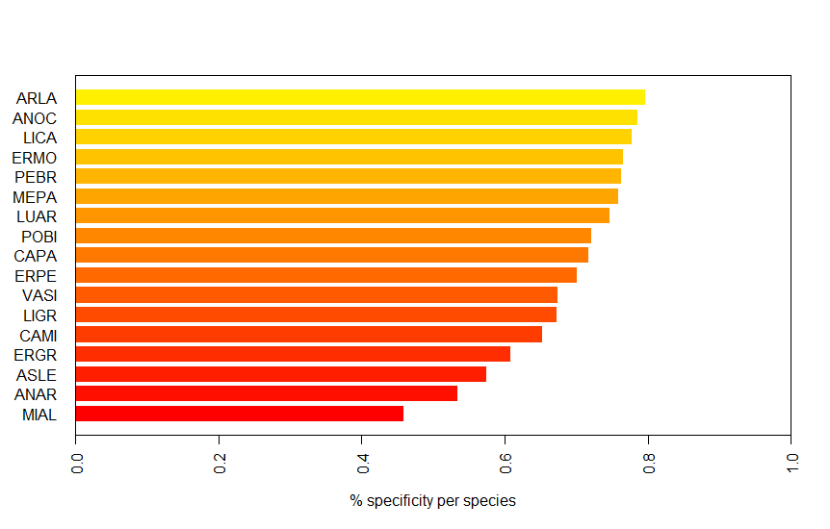

Slide 21
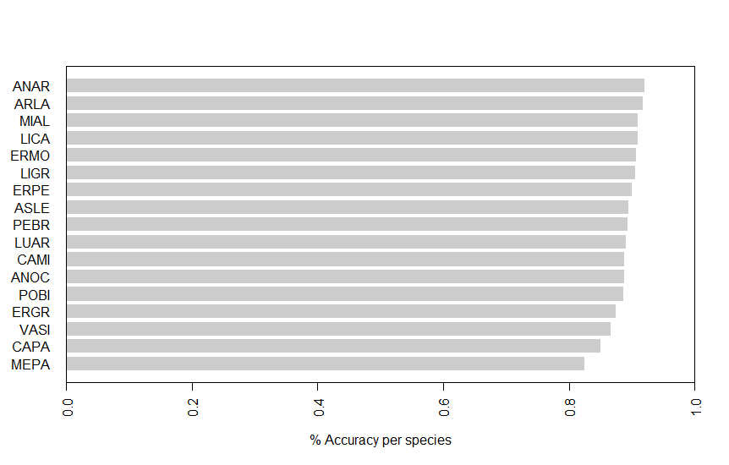
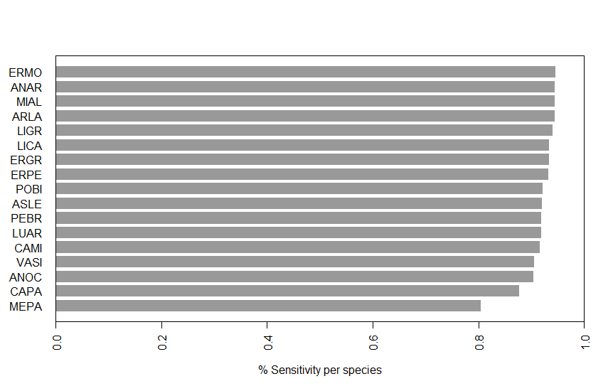
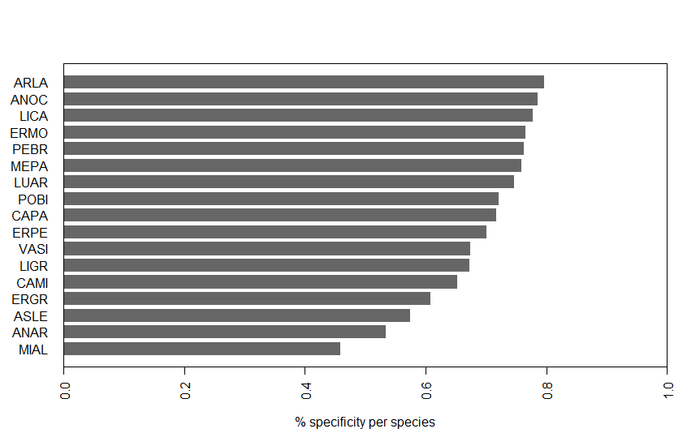

Slide 22
Data availability, usage, and privacy
MW raw data will be made available at the end of each growing season, after it has been quality controlled. MW data is freely available to use for any non-commercial purposes by citing this reference or the DOI to the database. Commercial uses of the database require the express authorization by the MW coordinator (currently: Prof. Dr. HilleRisLambers). To avoid any privacy issues, the identities of MW volunteers has been anonymized, being replaced by unique, semi-random sequences of numbers.

Slide 23
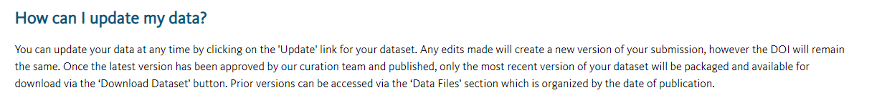
STRUCTURE:
Github (not updated to keep consistent with paper).
Dryad and link in text (updated annually, bi-annually with more data)
Dryad allows to produce versions and keep the newest version on top without changing DOI
https://datadryad.org/stash/faq

Slide 24
Link to provisional github:
https://github.com/rdmanzanedo/Open-Data-MeadoWatch
Link to very first text draft:
https://docs.google.com/document/d/101CBT2GUFirWMFm_pHwYSdolv_xV4OsDa3H95RNpcmU/edit

Slide 25
